Slide 1
Art of Enterprise UCIL24002
Creativity / Change Agent
Jonathan Styles
Simon 2.61

Slide 2


Slide 3
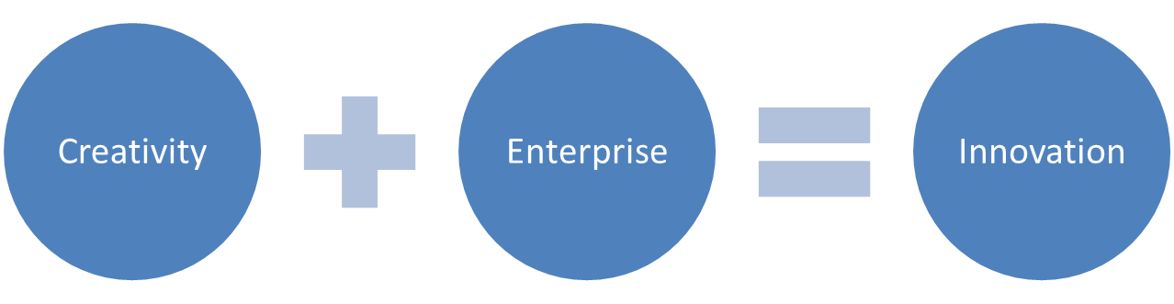
The art of enterprise
Idea
Opportunity
Evolution
Effect Change
  Leadership
  Judgement
  Networks
  People
  Planning
  Funding
  Connections
  Action
Notes:
The ‘art’ of being enterprising – is to make it really happen…To effect change…This takes work and effort…
Innovation is applied creativity…

Slide 4
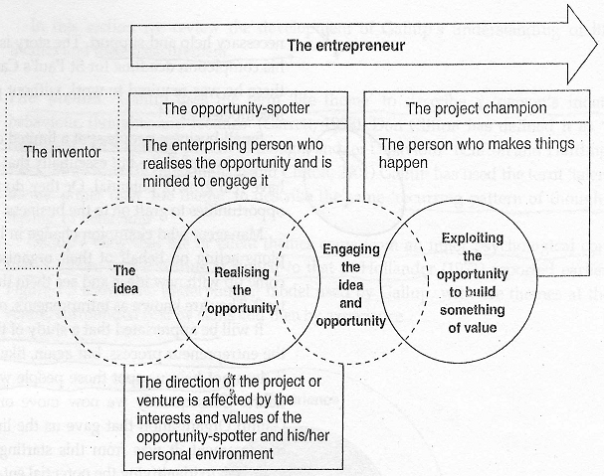
The entrepreneurial process
Innovation -
‘To put into use for
the first time’
Notes:
Creativity is the final ingredient in the opportunity-spotters recipe. Much has been written about different approaches to developing creativity, but little is applicable in every situation. Trott (1999, p13.) defines creativity as "the thinking of novel and appropriate ideas" Appropriate in that the solution should be useful, fit the problem and have value.
Entrepreneurs need to be creative in their thinking, both in terms of generating and recognising opportunities, and in terms of implementing these opportunities (Timmons, 1999). The generation of ideas requires the ability to think creatively and to see relationships others may not see - to think laterally, to think round corners, and to think beyond the problem in hand (Chell, 2001).

Slide 5
A Simple Framework
New product development (NPD) process or a staged gate process
Ideas
Feasibility
Capability
Implementation
LAUNCH GATE
CONTRACT GATE
CHARTER GATE
A, Ganguly, Business Driven R&D
Wheelwright & Clarke, Leading Product Development

Slide 6
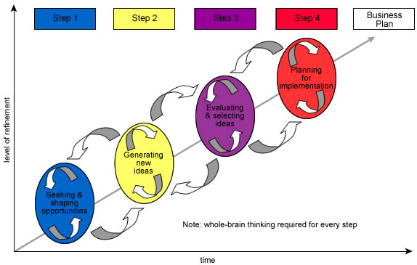
The Value Cycle
Strategic Roadmap
Value Proposition
Business Model
Spotting Opportunities
Bragg & Bragg (2006)
Notes:
Difficult to capture the complexity of the process
Logical and systematic progression in decision-making
Business start-up dynamic and interactive process NOT strictly sequential.
“trigger events” may influence founder:
Push factors (negative influence)
Pull factors (positive influence)
“It is a sad truism that founders rarely plan to fail; they simply fail to plan” (Beaver)
Individuals setting up a business in an area where they have had some experience as employees are more likely to succeed.
Importance of managerial competence in determining success.
⇒competencies can be taught to entrepreneurs (Storey, 1994)
BUT: Effective timing of training has not been established; e. g. prior to/at/following start-up.
Business start-up is not an event but a process.

Slide 7
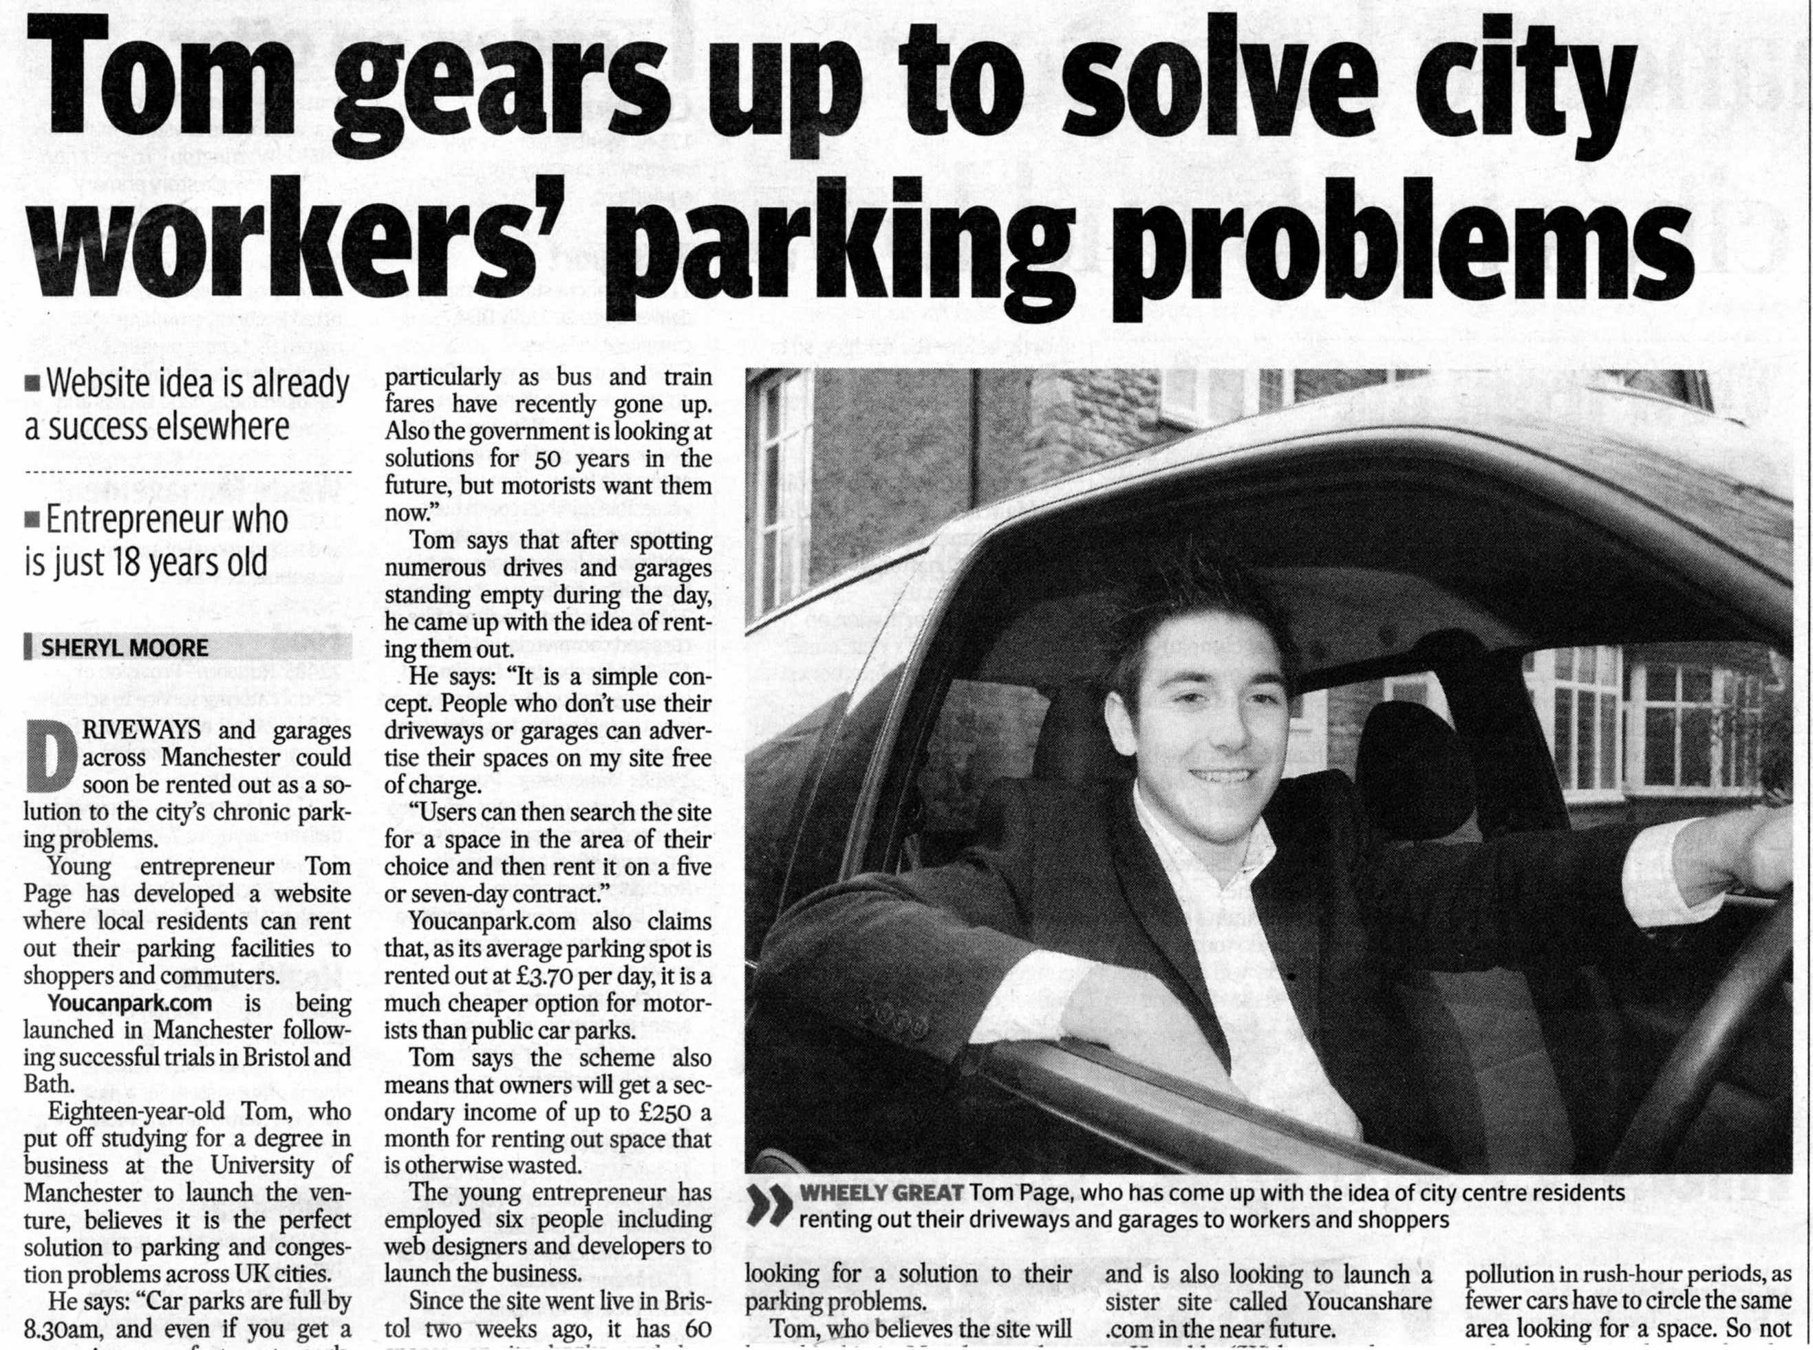
Sometimes the answer is on waiting on your doorstep!!

Slide 8
Creativity and innovation
“Creativity is thinking up new things. Innovation is doing new things”
Levitt, Harvard Business School
Creativity is "the thinking of novel and appropriate ideas“
Trott, 1999
“Entrepreneurs need to be creative in their thinking, both in terms of generating and recognising opportunities, and in terms of implementing these opportunities”
Timmons, 1999
“The generation of ideas requires the ability to think creatively and to see relationships others may not see - to think laterally, to think round corners, and to think beyond the problem in hand”
Chell, 2001
Notes:
The ability to associate unlike ideas is fundamental to innovation.
Overall associating is the key innovative skill because new ideas aren’t created without connecting problems or ideas in ways that haven’t been connected before.

Slide 9
Creativity

Slide 10
Perspectives on creativity…
A way of looking at things with a new and different perspective
Creativity can be thought of as:
a special quality - something only gifted people have
serendipitous - much evidence supports the lucky break theory
results from planned luck - looking for opportunities
results from endurance - hard work and persistence
can be encouraged by idea generation methods …

Slide 11

Think of as many uses as possible for an empty plastic bottle…can you think of 100…

Slide 12
Some ideas….
Storage vessel (obvious)
Funnel
Green house
Fishing trap
Insect trap
Scoop
Knife, fork, spoon
Protective cover

Slide 13
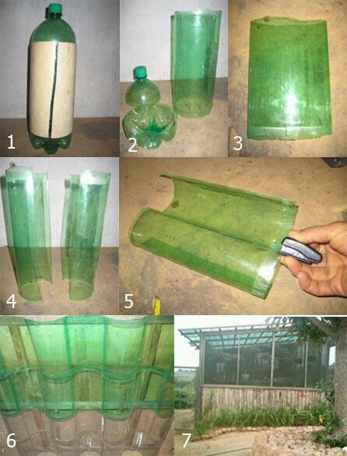
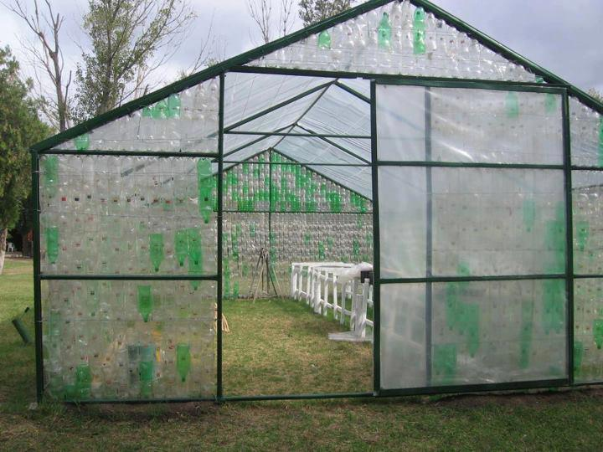
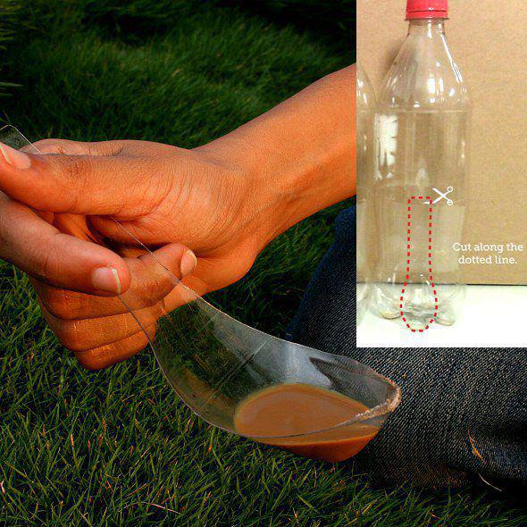
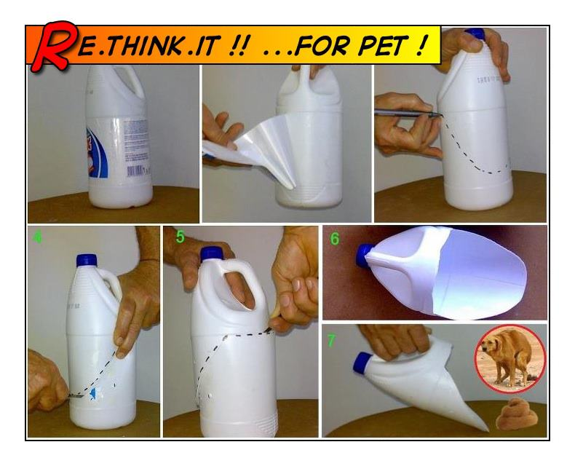
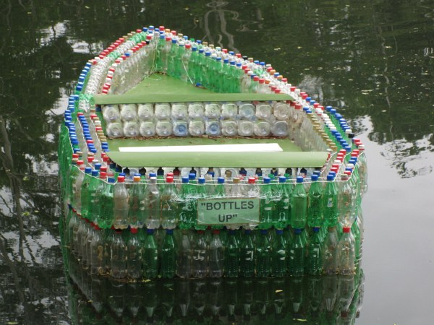

Slide 14
Creative people are…
What characteristics do creative people have?

Slide 15
Creative people are…
Aware of their creativeness
Independent
Self-confident
Risk-taking
High in energy
Enthusiastic
Spontaneous
Adventurous
Thorough
Curious
Have wide interests
Have a good sense of humour
Playful, childlike
Have artistic and aesthetic interests
Idealistic
Reflective
Need privacy and alone time
Attracted to novelty, complexity and the mysterious…

Slide 16
Barriers to creativity
What’s stopping us???
Creativity
Notes:
Overcoming barriers to creativity…
The attitude spectrum – excellent idea, but…
Bureaucracy

Slide 17
Barriers to creativity
The right answer is…
Creativity
That’s not logical…
Follow the rules…
Be practical…
Play is silly…
That’s not my area…
It’s being foolish…
I’m not creative…
Habit
Lack of stimulation
Fear of being wrong
https://www.ted.com/talks/ken_robinson_says_schools_kill_creativity/transcript

Slide 18
Where does creativity come from?
Divergent thinking
  The intellectual ability to think of many original, diverse and elaborate ideas
    Good for generating ideas (a scanning tool)
    Rubbish for evaluating ideas
Convergent thinking
  The intellectual ability to logically evaluate, critique and choose the best idea from a selection of ideas
    Good for evaluating ideas (a focusing tool)
    Rubbish for generating ideas
Notes:
What is creative thinking?

Slide 19

Things are not always logical…
Hard thinking
Soft thinking
Logical
Reasoned
Precise
Analytical
Specific
Linearity
Adult
Fantasy
Ambiguous
Dreamlike
Playful
Diffuse
Generalised
Childlike
idea

Slide 20
Look for more than one right answer…
The answer you get depends on the question you ask…
Keep looking for answers
Ask “what if” questions
Reverse the problem
Reword the question
“Nothing is more dangerous than an idea when it’s the only one you have”
Emile Chartier, French Philosopher

Slide 21

Break the rules
“Often you have to break out of one pattern to discover another one ”
Roger Von Oech “A Whack on the Side of the Head”
We rely on rules
They can restrict creativity
We need to:
Identify when we are following rules
Evaluate which rules are necessary
Ask “why this way?”
RULES

Slide 22
Break the rules…
Creative thinking may simply mean the realisation that there is no particular virtue in doing things the way they have always been done …
Sometimes:
We make rules for reasons that make sense
We follow these rules – the well trodden path…
Time passes and things change
The original reason for the rule generation may no longer exist but we continue to follow the rule
Notes:
Calf path poem…

Slide 23
When Change Doesn’t Happen?
When did you think about making something change (or wished that something could be different), but never achieved your desired outcome?
What stopped you?
How did you feel?
Never forget, “no” only means “no today”
….tomorrow may turn into a “yes”…

Slide 24
Don’t rely too much on the practical…
“Every child is an artist. The problem is how to remain an artist after growing up ”
Pablo Picasso
idea
Cultivate your imagination
Remain open minded when generating ideas
Look for positives in an idea as well as negatives and build on the positives
Play with ideas
Attempt things outside your expertise – develop the explorer attitude
Accept ambiguity
Accept it’s OK to be foolish
Challenge the rules and come up with alternatives
Accept failure and learn by it…

Slide 25
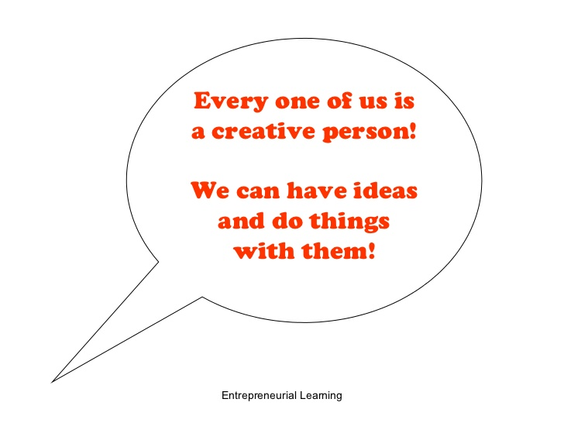

Slide 26
This game is designed to increase your flexibility and your ability to overcome the restrictions of habit. The name of what colour is concealed in each sentence?
Newspaper editors decided to go on strike. (Red)
A big, old, hungry dog appeared at our door every morning.
The cop persuaded him not to create a disturbance.
The Brazilian student Paulo lives around the corner from us.
You shouldn't let an upstart like him bother you.
He let out a big yell, owing to the injuries he received when he fell.
La Jolla venders decided to cut their prices in half.
Long rayon fabrics were loaded on the truck.
The Austrian physicist Wolfgang Pauli lacked the requisite documents to enter the U.S.
You shouldn't sell this fossil very cheaply because it is a rare specimen.
The new law hit everybody's pocketbook pretty hard.

Slide 27
This game is designed to increase your flexibility and your ability to overcome the restrictions of habit. The name of what colour is concealed in each sentence?
Newspaper editors decided to go on strike. (Red)
A big, old, hungry dog appeared at our door every morning.
The cop persuaded him not to create a disturbance.
The Brazilian student Paulo lives around the corner from us.
You shouldn't let an upstart like him bother you.
He let out a big yell, owing to the injuries he received when he fell.
La Jolla venders decided to cut their prices in half.
Long rayon fabrics were loaded on the truck.
The Austrian physicist Wolfgang Pauli lacked the requisite documents to enter the U.S.
You shouldn't sell this fossil very cheaply because it is a rare specimen.
The new law hit everybody's pocketbook pretty hard.

Slide 28

The question usually asked in connection with this design is whether you see either the vase or the two human profiles. A mentally flexible person will see both. For purposes of this mental exercise, however, try to see as many additional items in the picture as you can.

Slide 29
Try to cover the nine dots shown below with four straight and continuously drawn lines – the lines must be drawn without lifting the pen from the paper
● ● ●
● ● ●
● ● ●

Slide 30
Continue and explain the following letters progression:
A EF HI …………………
______________________________________
BCD G J………………

Slide 31
Continue and explain the following progression:
3 1 2 8 3 1 3 0 ………………..
Notes:
What is half of 18??

Slide 32
Tools to help develop creativity
Brainstorming
Customer focus groups
Creative groups to discuss ideas and concepts
  Uses for/improvements to/what-iffing…
  Feature stretching – develop new concepts
Reverse engineering – scrutinise competitor products
Mind mapping
Perceptual mapping
Involve others…
Notes:
Creativity can be developed and improved. The following are suggestions for techniques/approaches that may help:
Use focus groups to discuss customer needs.
Use creative groups to discuss ideas/concepts.
Use perceptual maps to plot competitor products/services on key product dimensions, and look for gaps.
Use feature stretching to develop new concepts.
Use reverse engineering to scrutinise competitor products/services.
Use product blending to develop new concepts.

Slide 33

Brainstorming and focus groups
Establish the stimulus
Select participants
Focus on quantity and withhold criticism
Welcome wild and unusual ideas
Build, combine and improve ideas…
Notes:
First you need to:
Establish the stimulus
Select the participants
Lay out the problem or issue in advance

Slide 34
De Bono’s ‘TEC’ framework
Target and Task
  Precise focus of thinking
  ‘How else could I perform the function’ or problem solving
Expand and Explore
  The opening up phase
  Expansion should be positive and free flowing
Contract and conclude
  The narrowing down phase
  What does it boil down to, what is the outcome/result
  The ‘5-minute’ TEC – 1+2+2

Slide 35

Mind mapping

Slide 36
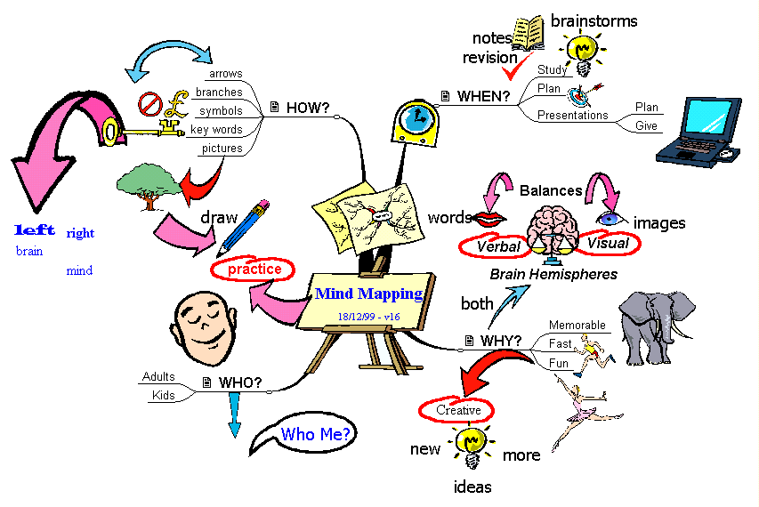
Mind mapping
http://www.schoolmaps.demon.co.uk/900-013.gif

Slide 37
Creativity as a life skill…the process of evolution
Gerard Puccio, Professor of Creativity, Buffalo State
http://www.youtube.com/watch?v=ltPAsp71rmI
3m

Slide 38
An opportunity for change…
Think about your experience at the University and discuss in groups what you would like to change…
Then pick one issue for your group to study…
Find a problem - fix a problem…

Slide 39
Defining and analysing
What will you change?
Why change? What’s the incentive?
Has this been tried before? Or elsewhere?
What would be the consequences of change?
Who are the stakeholders – those with influence, those effected and those who could offer support?
  How can you engage with these people?
  How do they prefer to communicate?
Where is the power/the influence/the levers?
What are the restrictions or rules to be aware of?
What barriers to change do you foresee?
What are the risks? (to you, to others)
Imagine success – negative thinking is itself a barrier to change

Slide 40
But change is unsettling…
How important is routine to you? – Habitual – Habit stacking
How do you react to change? Different personality types mean some people react better to change than others
What affects how you feel about change being imposed upon you, whether you benefit from it or not?
What does control over change imply about relative power and status?
How might your assumptions differ from other peoples? How might they view you, your motives and your credibility? How can you influence other peoples’ perceptions of you?
“Whenever a person or organisation imposes new things on people there will be difficulties. Participation, involvement and open, early, full communication are important factors.”

Slide 41
Turning ideas into actions
With your chosen idea, what stages can you break the activities into, to end up with a plan comprising a series of manageable steps?
  What skills and information will you need to pursue each stage? Where will you find them?
  Who is involved in each step? How will you gain their co-operation and inspire or motivate them to action?
  What resource is needed for each stage? Who pays?
  What timescale will you set for each stage?
  What are your success criteria for each stage?
  “If you're walking down the right path and you're willing to keep walking, eventually you'll make progress.” Barack Obama

Slide 42
Being a change agent…
What “quick wins” can you build in early in the process to drive momentum?
How can you keep yourself as well as your collaborators engaged and enthusiastic?
How can you enforce your timetable and celebrate success at each stage, to prevent inertia setting in?
What contingency measures can you prepare in case of unforeseen problems requiring you to revisit or modify your action plan?
What would trigger you putting your plans on hold or making the decision not to pursue them further?
“Please grant me the serenity to accept the things I cannot change, the courage to change the things I can and the wisdom to know the difference”

Slide 43
Understanding change…
John Kotter’s 'Leading Change' (1995) and 'The Heart Of Change' (2002) describe a model for understanding and managing change, summarised as:
Increase urgency - inspire people to move, make objectives real and relevant.
Build the guiding team - get the right people in place with the right emotional commitment, and the right mix of skills and levels.
Get the vision right - get the team to establish a simple vision and strategy, focus on emotional and creative aspects necessary to drive service and efficiency.
Communicate for buy-in - Involve as many people as possible, communicate the essentials, simply, and to appeal and respond to people's needs. De-clutter communications - make technology work for you rather than against.
Empower action - Remove obstacles, enable constructive feedback and lots of support from leaders - reward and recognise progress and achievements.
Create short-term wins - Set aims that are easy to achieve - in bite-size chunks. Manageable numbers of initiatives. Finish current stages before starting new ones.
Don't let up - Foster and encourage determination and persistence - ongoing change - encourage ongoing progress reporting - highlight achieved and future milestones.
Make change stick - Reinforce the value of successful change via recruitment, promotion, new change leaders. Weave change into culture.

Slide 44
But making it happen is…
… fundamentally about people – otherwise ideas just remain ideas…

Slide 45
Activity…
A creative use for redundant retail premises is to set up a ‘pop-up’ shop – offering new business opportunities…
Using a ‘mind map’ - list all the possible ideas for a pop-up business on, or close to, the University campus.

Slide 46
Useful web sites…
www.creativitypool.com
www.creativityatwork.com
www.infinn.com
www.brainstorming.co.uk
www.mind-mapping.co.uk

Slide 47
Some references…
Opportunity-Centred Entrepreneurship, Rae, 2015, Palgrave
Opportunity Recognition, Lumkin, Hills & Schrader, CEAE White Paper, 2001
The Art of Innovation, Kelley, 2001, Profile
A Technique for Producing Ideas, James Webb Young, 2003, McGraw Hill
Edward De Bono’s Thinking Course, Edward De Bono
Sticky Wisdom – Whatif

